Slide 1
KCSE Results Analysis 2006-2020
This is a presentation of the results from an analysis conducted on Kenya Certificate of Secondary Education examinations results from the year 2006 to 2020
Objective
To identify trends and patterns in the performance of students who sat for KCSE in the said years.

Slide 2
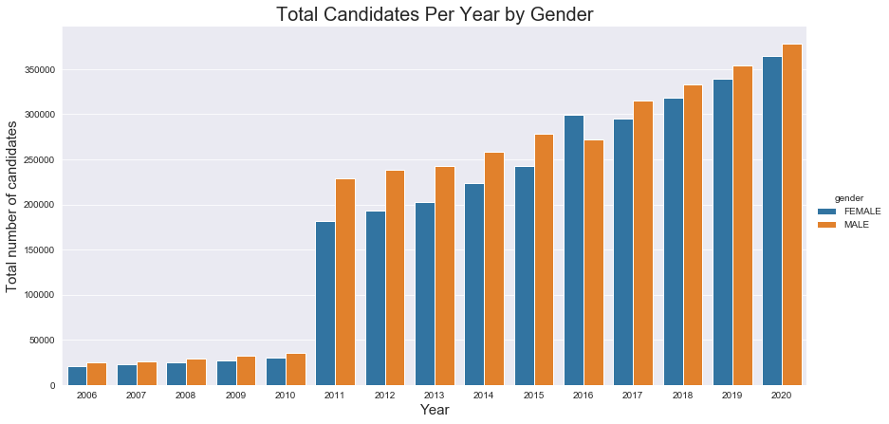
Graph showing how the number of students sitting for KCSE changed over the years.

Slide 3
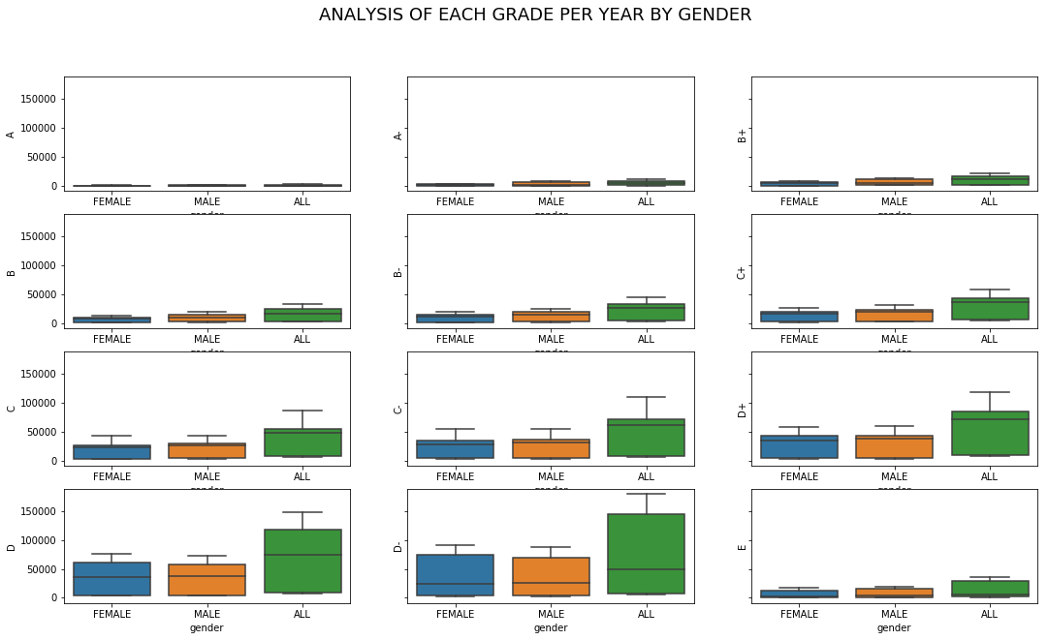
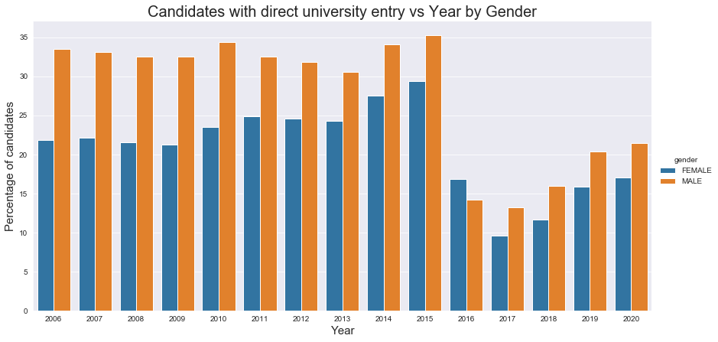
Graph showing percentage of students per gender who got direct entry to the university. These are the students who had C+ and above.

Slide 4
This graph shows the distribution of different grades by Gender.

Slide 5
Conclusion
-The number of candidates sitting for KCSE has increased over the years showing that more young kenyans are getting an education.
-The percentage of students getting direct entry to University has decreased from 2016 to 2020 with less than a quarter(25%) getting direct entry.
-With an increase in the number of students sitting exams the percentage of direct entry students should also increase.
- Given the continued efforts to get more girls to school, compared to male students lesser girls still sit for the exams. This might be due to other factors not presented in the data.
-The higher grades are still significantly low meaning not many students get C+ and above. Therefore, few students get direct entry to pursue degree courses.
- In 2015 there was a high number in exam irregularities which may have affected the quality of results.
- Exam irregularities should also be included in the data to give a more comprehensive understanding on how it affects the quality of results.

